Slide 1
Overview: Reconnaissance, Recognition, and Response
Chapter 43 – The Immune System

Slide 2
Innate Immunity:
Present before any exposure to pathogens and is effective from the time of birth.
Involves nonspecific responses to pathogens.
Rapid response time.
Consists of external barriers plus internal cellular and chemical defenses.

Slide 3
Adaptive Immunity:
Also called acquired immunity, develops after exposure to agents such as microbes, toxins, or other foreign substances.
Slower response time.
Involves response to a specific pathogen

Slide 4
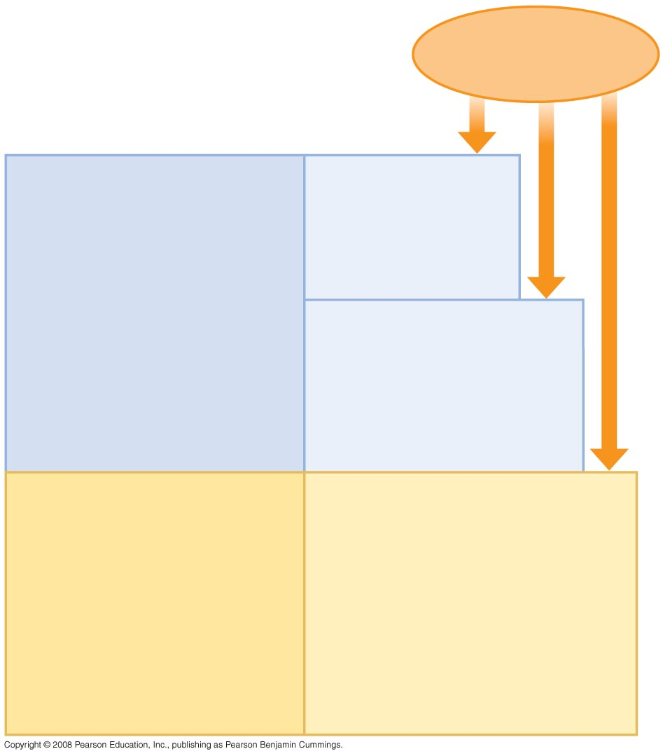
Pathogens
(microorganisms
and viruses)
INNATE IMMUNITY
Barrier defenses:
Skin
Mucous membranes
Secretions
•
Recognition of traits
shared by broad ranges
of pathogens, using a
small set of receptors
Internal defenses:
Phagocytic cells
Antimicrobial proteins
Inflammatory response
Natural killer cells
•
Rapid response
ACQUIRED IMMUNITY
Humoral response:
Antibodies defend against
infection in body fluids.
•
Recognition of traits
specific to particular
pathogens, using a vast
array of receptors
Cell-mediated response:
Cytotoxic lymphocytes defend
against infection in body cells.
•
Slower response

Slide 5
Inflammatory Responses
Following an injury, mast cells release histamine, which promotes changes in blood vessels.
These changes increase local blood supply and allow more phagocytes and antimicrobial proteins to enter tissues.
Pus, a fluid rich in white blood cells, dead microbes, and cell debris, accumulates at the site of inflammation.

Slide 6
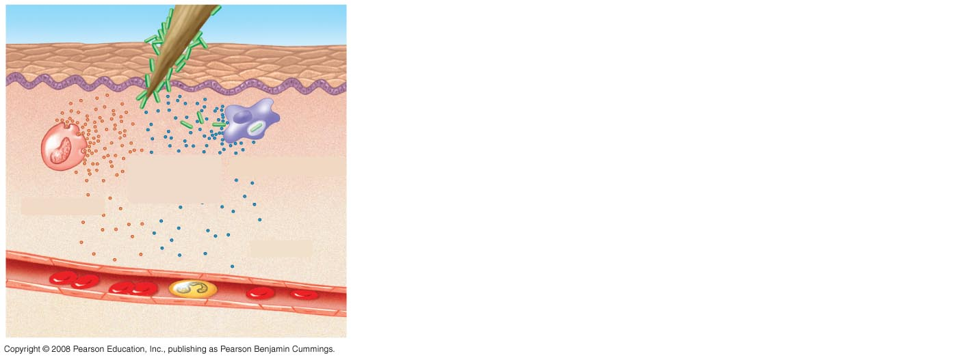
Fig. 43-8-1
Pathogen
Splinter
Chemical
signals
Macrophage
Mast cell
Capillary
Red blood cells
Phagocytic cell

Slide 7
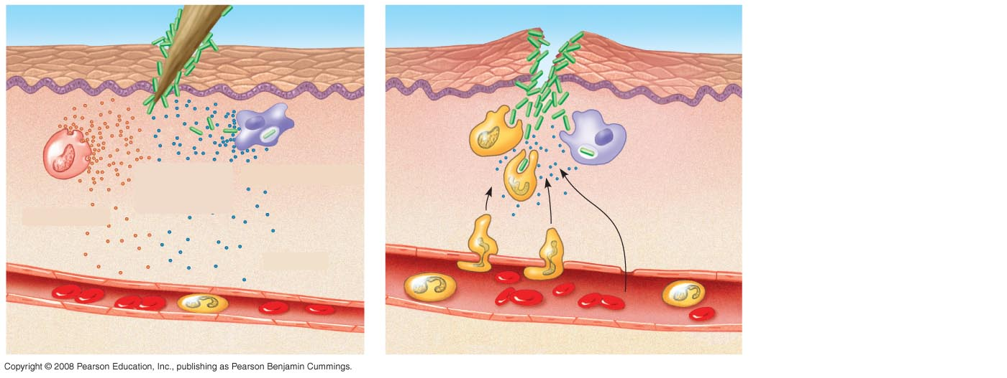
Fig. 43-8-2
Pathogen
Splinter
Chemical
signals
Macrophage
Mast cell
Fluid
Capillary
Red blood cells
Phagocytic cell

Slide 8
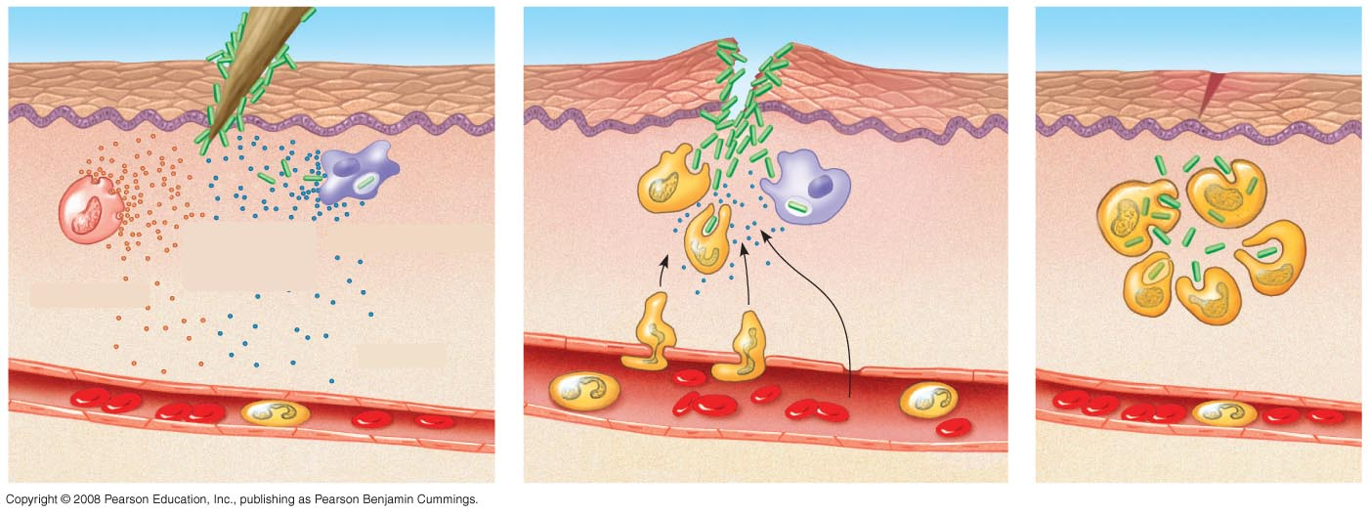
Fig. 43-8-3
Pathogen
Splinter
Chemical
signals
Macrophage
Mast cell
Fluid
Capillary
Phagocytosis
Red blood cells
Phagocytic cell

Slide 9
Adaptive Immunity
A response is coordinated to a specific invader
Lymphocytes that mature in the thymus (small organ b/w lungs) are called T cells
Lymphocytes that mature in bone marrow are called B cells.

Slide 10
Adaptive Immunity: An Overview
B cells and T cells have antigen recognition proteins that can bind to pathogens.

Slide 11
Antigen Recognition by Lymphocytes
An antigen is any foreign molecule which B or T cells respond to
A single B cell or T cell has about 100,000 identical antigen receptors.

Slide 12
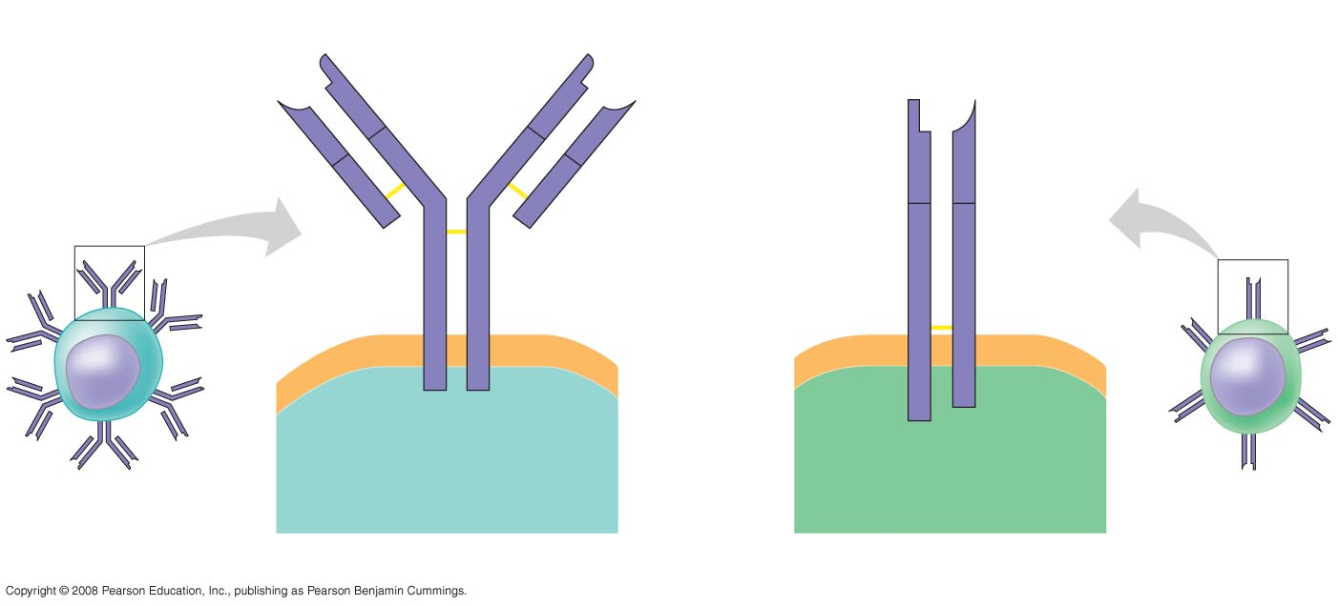
Antigen-
binding
site
Antigen-
binding site
Antigen-
binding
site
V
Disulfide
bridge
V
V
V
Variable
regions
V
V
C
C
C
C
Constant
regions
C
C
Light
chain
Transmembrane
region
Plasma
membrane
Heavy chains
 chain
 chain
Disulfide bridge
B cell
Cytoplasm of B cell
Cytoplasm of T cell
T cell
(a) B cell receptor
(b) T cell receptor

Slide 13
Antigen Presentation
A phagocyte must engulf, digest, then present the antigen on its cell surface for T cells to detect it
A B cell can either engulf a pathogen itself and present the antigen, or detect an antigen from a phagocyte

Slide 14
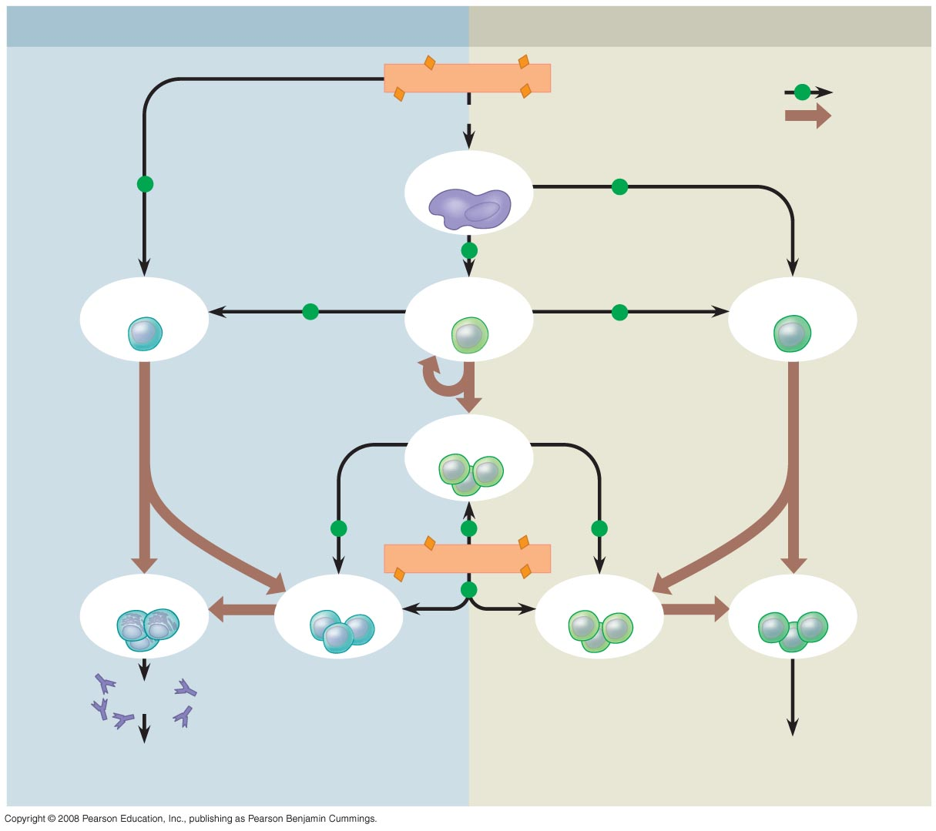
Humoral (antibody-mediated) immune response
Cell-mediated immune response
Antigen (1st exposure)
Key
+
Stimulates
Gives rise to
Engulfed by
Antigen-
presenting cell
+
+
+
B cell
+
Helper T cell
+
Cytotoxic T cell
Memory
Helper T cells
+
+
+
Antigen (2nd exposure)
Plasma cells
Memory B cells
+
Memory
Cytotoxic T cells
Active
Cytotoxic T cells
Secreted
antibodies
Defend against extracellular pathogens by binding to antigens,
thereby neutralizing pathogens or making them better targets
for phagocytes and complement proteins.
Defend against intracellular pathogens
and cancer by binding to and lysing the
infected cells or cancer cells.

Slide 15
Antigen-
binding
site
Antigen-
binding site
Antigen-
binding
site
V
Disulfide
bridge
V
V
V
Variable
regions
V
V
C
C
C
C
Constant
regions
C
C
Light
chain
Transmembrane
region
Plasma
membrane
Heavy chains
α chain
β chain
Disulfide bridge
B cell
Cytoplasm of B cell
Cytoplasm of T cell
T cell
(a) B cell receptor
(b) T cell receptor

Slide 16
Generation of Lymphocyte Diversity by Gene Rearrangement
Many different chains can be produced from the same gene by selectively transcribing the DNA
This leads to the different shapes of the variable region

Slide 17
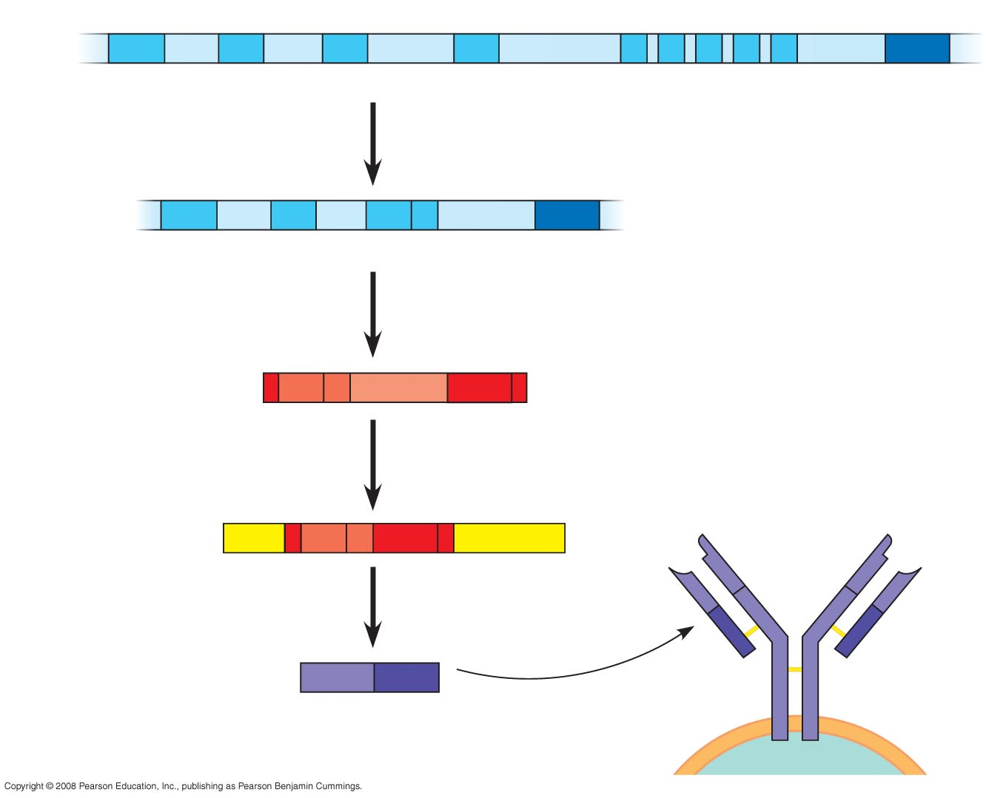
DNA of undifferentiated B cell
V₃₇
V₃₈
V₃₉
V₄₀
J₁
J₂
J₃
J₄
J₅
Intron
C
1
DNA deleted between randomly selected V and J
segments
DNA of differentiated B cell
V₃₇
V₃₈
V₃₉
J₅
Intron
C
Functional gene
2
Transcription
pre-mRNA
V₃₉
J₅
Intron
C
3
RNA processing
V₃₉
J₅
B cell receptor
mRNA
Cap
C
Poly-A tail
V
V
4
Translation
V
V
C
C
Light-chain polypeptide
V
C
C
C
Variable
region
Constant
region
B cell

Slide 18
Origin of Self-Tolerance
Antigen receptors are generated by random rearrangement of DNA.
As lymphocytes mature in bone marrow or the thymus, they are tested for self-reactivity.
Lymphocytes with receptors specific for the body’s own molecules are destroyed by apoptosis, or rendered nonfunctional.
Question – what would happen if these cells were NOT destroyed?

Slide 19
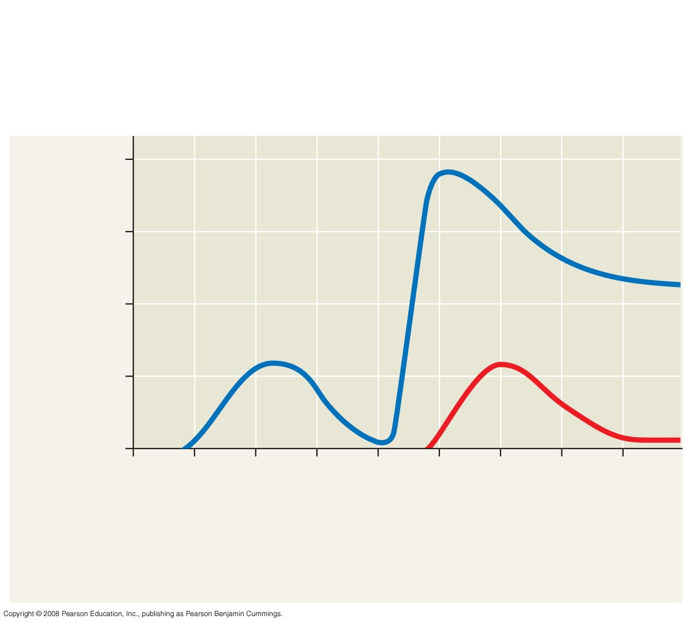
Primary immune response
to antigen A produces
antibodies to A.
Secondary immune response to
antigen A produces antibodies to A;
primary immune response to antigen
B produces antibodies to B.
10⁴
10³
Antibody concentration
(arbitrary units)
Antibodies
to A
10²
Antibodies
to B
10¹
10⁰
0
7
14
21
28
35
42
49
56
Exposure
to antigen A
Exposure to
antigens A and B
Time (days)

Slide 20
Acquired immunity defends against infection of body cells and fluids
Humoral response involves activation and division of B cells, which produce antibodies
Cell-mediated response involves activation and division of cytotoxic T cells which attack infected cells

Slide 21
Humoral (antibody-mediated) immune response
Cell-mediated immune response
Antigen (1st exposure)
Key
+
Stimulates
Gives rise to
Engulfed by
Antigen-
presenting cell
+
+
+
B cell
+
Helper T cell
+
Cytotoxic T cell
Memory
Helper T cells
+
+
+
Antigen (2nd exposure)
Plasma cells
Memory B cells
+
Memory
Cytotoxic T cells
Active
Cytotoxic T cells
Secreted
antibodies
Defend against extracellular pathogens by binding to antigens,
thereby neutralizing pathogens or making them better targets
for phagocytes and complement proteins.
Defend against intracellular pathogens
and cancer by binding to and lysing the
infected cells or cancer cells.

Slide 22
The Role of Antibodies in Immunity
Neutralization occurs when a pathogen can no longer infect a host because it is bound to an antibody.
Opsonization occurs when antibodies bound to antigens increase phagocytosis.

Slide 23
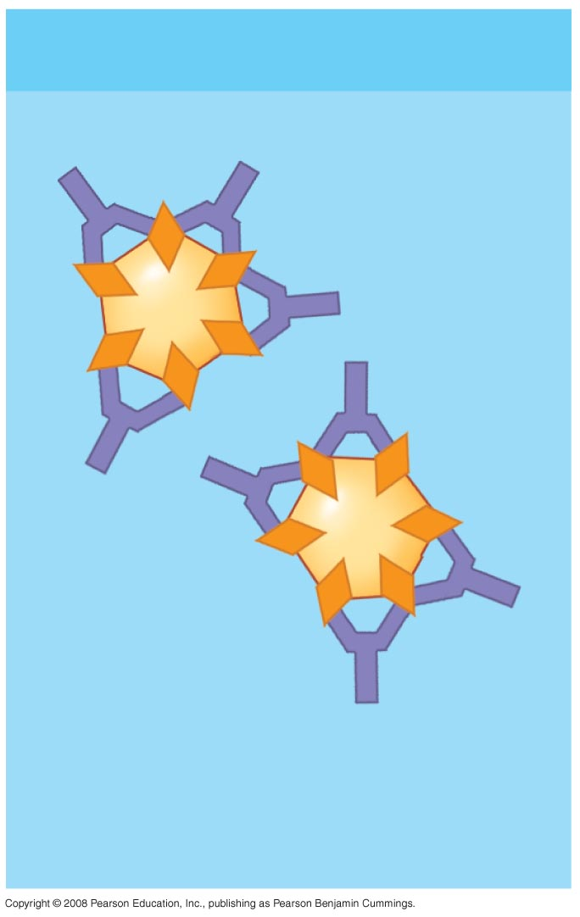
Viral neutralization
Virus

Slide 24
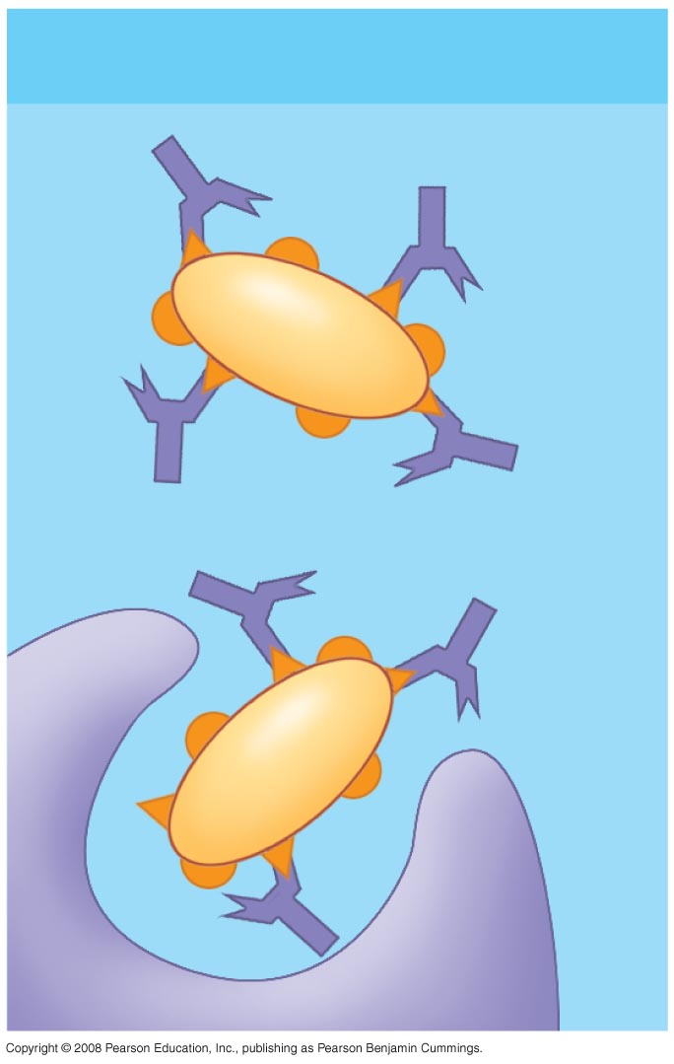
Opsonization
Bacterium
Macrophage

Slide 25
Active and Passive Immunization
Active immunity develops naturally in response to an infection
It can also develop following vaccination
In vaccination, the antigen alone is presented to create memory B and T cells

Slide 26
Passive Immunity
Provides short-term protection
Occurs when immune cells cross the placenta from mother to fetus or when antibodies pass through breast milk

Slide 27
Acquired Immune System Evasion by Pathogens
Pathogens adapt too!
Pathogens have high mutation rates in their antigens, decreasing detection
Lysogenic viruses remain dormant in the body and cannot be cured

